Slide 1
Diacritization of Arabic Text
Supervisor: Dr. Mubasher Baig
Group members:
Saadi Ahmad Ali 16L-4331
Afrasiyab 16L-4285
Ahmed Bilal Bahadur 16L-4237
Saqib Rashid 16L-4206

Slide 2
introduction

Slide 3
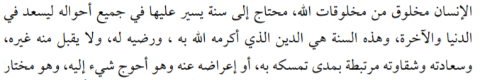
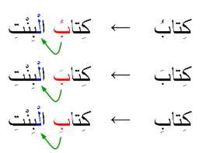
Problem Statement
Arabic is usually written without short vowels (a.k.a. diacritics),
except in sacred text.
One word without these vowels may have several possible correct
markings.
Place of markings:
On the last letter of the word (case-endings)
All other previous letters

Slide 4


Diacritic on the Last Letter
Determines the role of the word in the sentence; e.g., a subject or object.
Depends on the context, that is why RNN is a better approach.
When considered, it gives a lower accuracy.
ضرب حامد
ضَرَبَ حامِداً
ضَرَبَ حامِدٌ
He hit Hamid
Hamid hit (someone)

Slide 5


Diacritics on Other Letters
Determine the meaning of the word, therefore, it may change the part of speech (POS) as well.
Equivalent to selecting the correct word.
كاتب
كاتَبَ
كاتِبٌ
To correspond
(verb)
Writer
(noun)

Slide 6
Implementation

Slide 7
Brief Summary
Implementation of multilayered Encoder-decoder model containing Bidirectional Long-Short Term Memory neurons.
Pre-processing of training data in order to prepare the data to feed into the model.
Post-processing on model results.

Slide 8
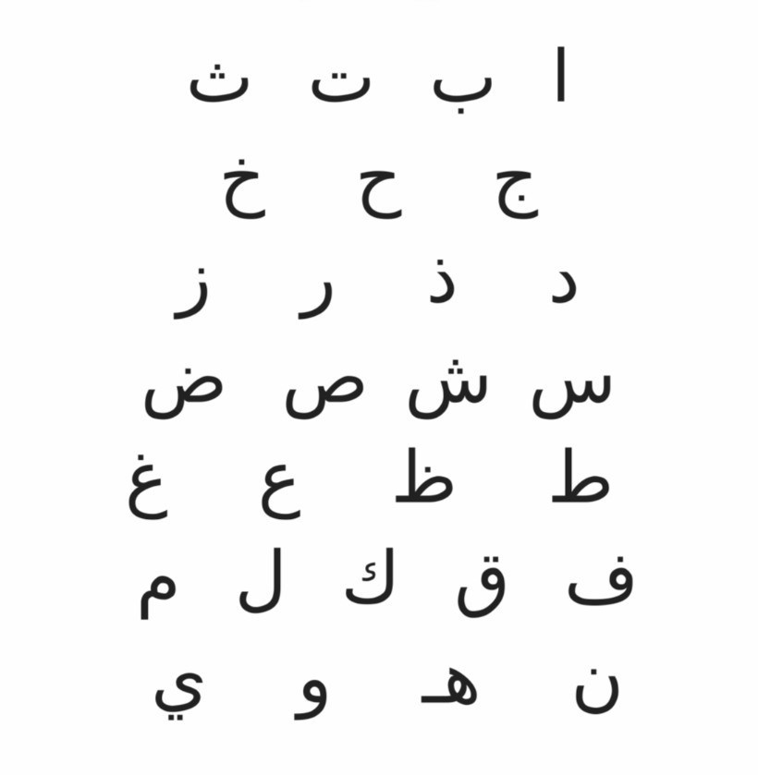
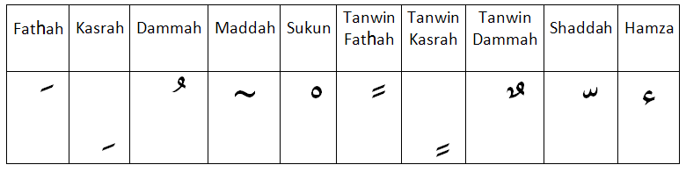
Details
Python 3.7, Jupyter Notebook on Anaconda.
Libraries: Keras, Numpy and Matplotlib
Pre-processing:
Separate list for Arabic letters and Arabic diacritics

Slide 9
Pre-processing
Undiacritizing training Arabic text
الْمَسْجِد
المسجد
- | ِ | ْ | َ | ْ | -

Slide 10
Pre-processing (Cont.)
Encoding Arabic letters and diacritics
المسجد
- | ِ | ْ | َ | ْ | -
15 | 12 | 19 | 31 | 30 | 7
0 | 9 | 11 | 7 | 11 | 0

Slide 11
Pre-processing (Cont.)
Sequence formation for input and target values
15 | 12 | 19 | 31 | 30 | 7
0 | 9 | 11 | 7 | 11 | 0
12 | 19 | 31 | 30 | 7
1
9 | 11 | 7 | 11 | 0
1
15 | 12 | 19 | 31 | 30
2
0 | 9 | 11 | 7 | 11
2

Slide 12
Encoder – decoder BLSTM Model
Timestamps are sequences we made.
Notes:
Timestamps and sequences are interchangeable terms

Slide 13
Encoder – decoder BLSTM Model (Cont.)
Two Bidirectional LSTM layers each contain 200 units connected by repeatvector layer.
Repeatvector layer repeats and provides the very last output to the decoder input.
Epochs = 10
Notes:
Timestamps and sequences are interchangeable terms

Slide 14
Post-processing
A problem while predicting: multiple predictions for some characters.
Solution: assign their mode values to the characters.
12 | 19 | 31 | 30 | 7
15 | 12 | 19 | 31 | 30

Slide 15
Post-processing (Cont.)
Improving results using edit distance approach.
Idea: find the closest word to the word formed after predictions using dictionary.
For each word in the input text, closest word in the dictionary is found and the predicted word is replaced with that word.

Slide 16
TRAINING & results

Slide 17
Training Details
Hardware
GPU: Google Colab
Statistics
Total 5 epochs: One epoch takes approximately one hour
Total training time = 5 x 1 = 5 hours

Slide 18
Testing Details
Complete text diacritized iteratively using For-Loop.
Every iteration diacritizes a sequence of 5 characters.
There is no limit on the size of input.

Slide 19
Techniques That Were Implemented
BLSTM (Binary Long Short Term Memory)
Encoder-Decoder LSTM
Encoder-Decoder BLSTM

Slide 20
Results
 | Training Data | Test Data | Training DER | Test DER | Test DER After Post Processing
BLSTM | 3615 Sentences | 100 Sentences | 80% | N/A | N/A
Encoder Decoder LSTM | 3615 Sentences | 100 Sentences | 64% | 64% | 21%
Encoder Decoder BLSTM | 3615 Sentences | 100 Sentences | 60% | 60% | 21%

Slide 21
Comparison
Accuracy (DER) | Training Data | Training Time | Epochs
79.93% | 3,617 | 5 hours | 5
96.27% | 50,000 | 3 months | Unknown

Slide 22
Future work

Slide 23
Overview of Future Work
Increase training dataset from 3617 to 50,000 sentences.
Use a sequence size other than 5.

Slide 24
demo

